Slide 1
The Disaster Tweets -
Text Classification
CAI Shizhan, SONG Wenxin

Slide 2
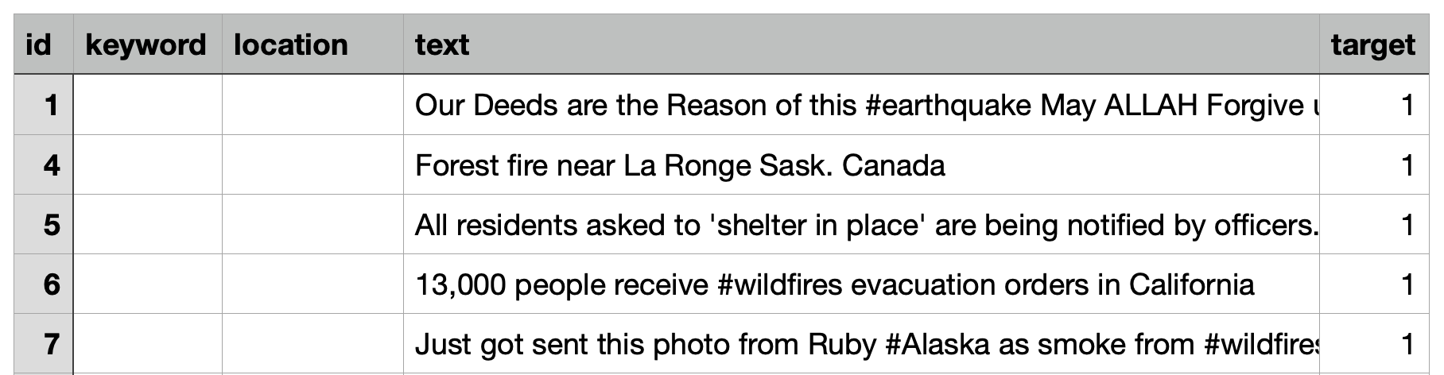
A Kaggle Competition
Dataset
Natural Language Processing with Disaster Tweets
Predict which Tweets are about real disasters and which ones are not

Slide 3
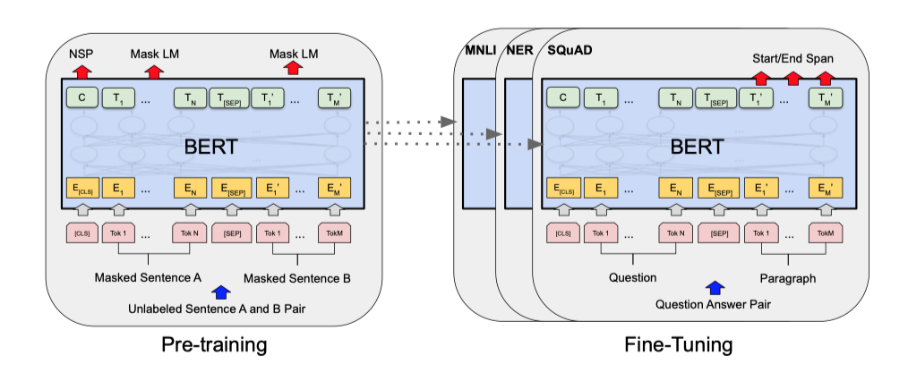
BERT: Bidirectional Encoder Representation from Transformer
A cutting-edge model proposed in 2019

Slide 4
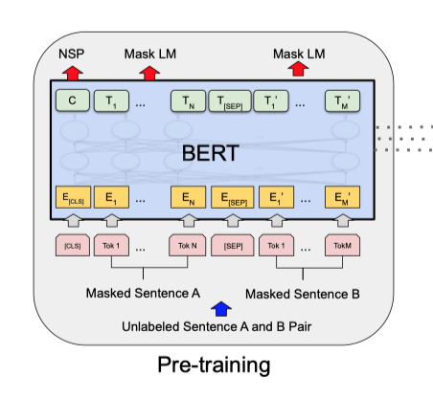
1.1 Pre-training
Task #1: Masked LM
Randomly mask 15% of the tokens and calculate the loss on the masked tokens.
Task #2: Next Sentence Prediction (NSP)
Choosing the sentences A and B for each pretraining example, 50% of the time B is the actual next sentence that follows A

Slide 5
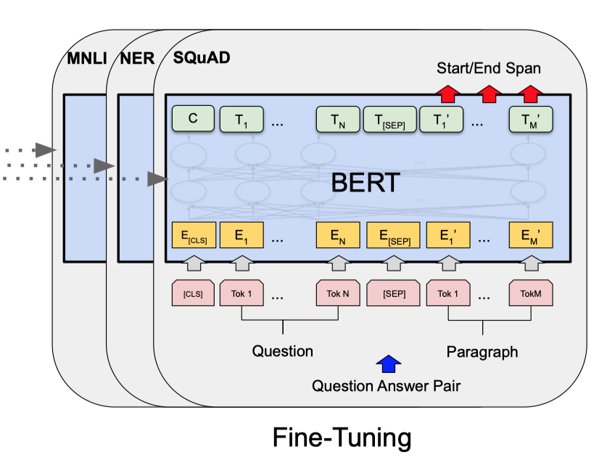
1.2 Fine-tuning
Tune hyperparamters for each task:
Batch size, Learning rate (Adam), Number of epochs...

Slide 6
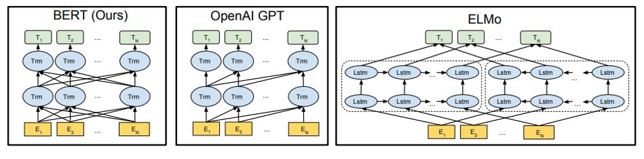
1.3 Comaprison
Outperformed many other popular models at that time:
OpenAI GPT: single directional
ELMo: Uses different objective functions.

Slide 7
2. RoBERTa:
A Robustly Optimized BERT Pretraining Approach
Key differences:
(1) dynamically changing the masking pattern;
(2) removing the next sentence prediction objective;
(3) training the model longer, with bigger batches, over more data and longer sequence;

Slide 8
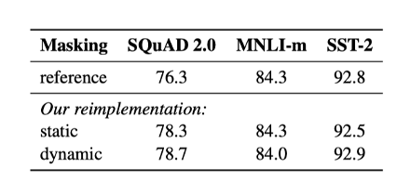
2.1 Static vs. Dynamic Masking
BERT: performed masking once during data preprocessing, resulting in a single static mask.
RoBERTa: Uses a method that mimics dynamic masking. Avoid using the same mask for every training.

Slide 9
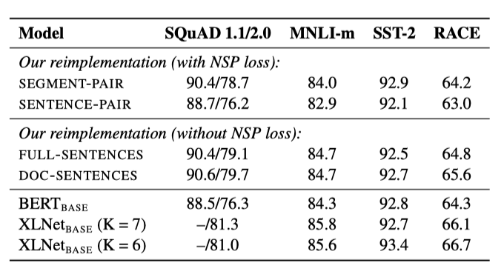
2.2 Model Input Format and Next Sentence Prediction
SEGMENT- PAIR + NSP: Original input format used in BERT
SENTENCE - PAIR + NSP: Each input contains a pair of natural sentences, either sampled from a contiguous portion of one document or from separate documents.
FULL - SENTENCES: Each input is packed with full sentences sampled contiguously from one or more documents, such that the total length is at most 512 tokens.
DOC - SENTENCES: Inputs are constructed similarly to FULL - SENTENCES, except that they may not cross document boundaries.

Slide 10
2.3 Text Encoding
BERT: Uses a character-level BPE vocabulary of size 30K
RoBERTa: Uses a larger byte-level BPE vocabulary containing 50K subword units
Reason:
‘Using bytes makes it possible to learn a subword vocabulary of a modest size (50K units) that can still encode any input text without introducing any “unknown” tokens.’

Slide 11
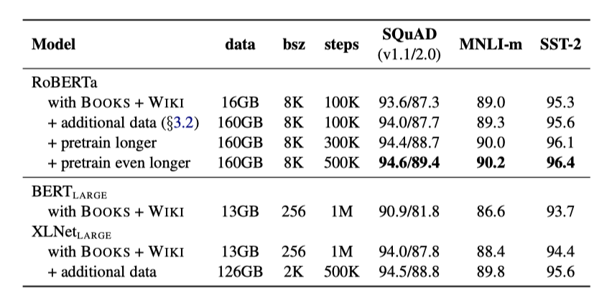
2.4 Summary

Slide 12
2.5 RoBERTa result on the dataset
Accuracy on validation set: 0.80
Result on testing set at Kaggle:
F1 score: 0.81458,
Ranking: 221

Slide 13
3. XLNet

Slide 14



One Flew Over the Cuckoo's Nest Sesame Street
ELMo
BERT
XLNet

Slide 15
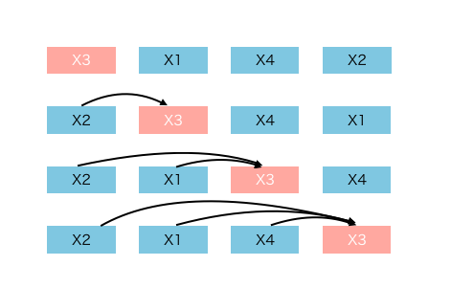
3.1 Autoregressive(AR)
The process of generating a sentence is as follows: generate the first word according to the probability distribution, then generate the second word according to the first word, and then generate the third word according to the first two words, ... until the entire sentence is generated
Notes:
where hθ(x1:t−1) is a context representation produced by neural models, such as RNNs or Transformers.
and e(x) denotes the embedding of x

Slide 16
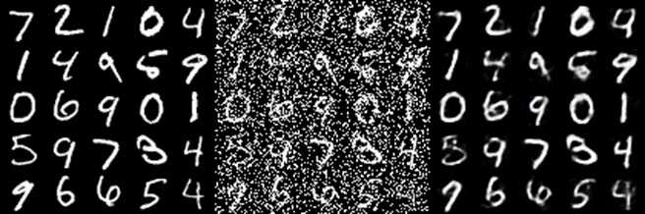
3.2 Denoising Autoencoders(DAE)
Autoencoders are Neural Networks which are commonly used for feature selection and extraction. Denoising Autoencoders corrupts the data on purpose by randomly turning some of the input values to zero
Notes:
In comparison, BERT is based on denoising auto-encoding. Specifically, for a text sequence x, BERT first constructs a corrupted version xˆ by randomly setting a portion (e.g. 15%) of tokens in x to a special symbol [MASK]. Let the masked tokens be x_bar. The training objective is to reconstruct x_ bar from x_hat: where mt = 1 indicates xt is masked, and Hθ is a Transformer that maps a length-T text sequence x into a sequence of hidden vectors Hθ(x) = [Hθ(x)1, Hθ(x)2, · · · , Hθ(x)T ]. T

Slide 17
3.3 Pros and Cons of the two pretraining objectives
Independence Assumption: As emphasized by the ≈ sign in Eq. (2), BERT factorizes the joint conditional probability p(x_bar|x_hat) based on an independence assumption that all masked tokens x_bar are separately reconstructed. In comparison, the AR language modeling objective (1) factorizes p_θ(x) using the product rule that holds universally without such an independence assumption.
For example, “New”, ”York” are independent assumed by BERT model, but we know they are highly corelated.

Slide 18
3.3 Pros and Cons of the two pretraining objectives
Input noise: The input to BERT contains artificial symbols like [MASK] that never occur in downstream tasks, which creates a pretrain-finetune discrepancy. Replacing [MASK] with original tokens as in BERT paper
(In the paper, “masked” token with (1) 80% the [MASK] token (2) 10% a random token (3) 10% the unchanged token)
does not solve the problem because original tokens can be only used with a small probability — otherwise Eq. (2) will be trivial to optimize. In comparison, AR language modeling does not rely on any input corruption and does not suffer from this issue.

Slide 19
3.3 Pros and Cons of the two pretraining objectives
Context dependency: The AR representation hθ(x1:t−1) is only conditioned on the tokens up to position t (i.e. tokens to the left), while the BERT representation Hθ(x)t has access to the contextual information on both sides. As a result, the BERT objective allows the model to be pretrained to better capture bidirectional context.

Slide 20
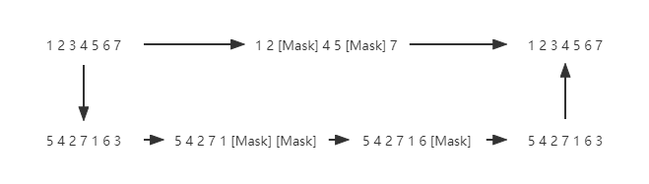
3.4 Permutation Language Modeling(PLM)
Randomly select one kind of sentence permutation, and then "mask" a certain amount of words at the end, and finally use AR to predict the words that are "masked" according to this arrangement.
Remark: The proposed objective only permutes the factorization order, not the sequence order. In other words, we keep the original sequence order, use the positional encodings corresponding to the original sequence, and rely on a proper attention mask in Transformers to achieve permutation of the factorization order.

Slide 21
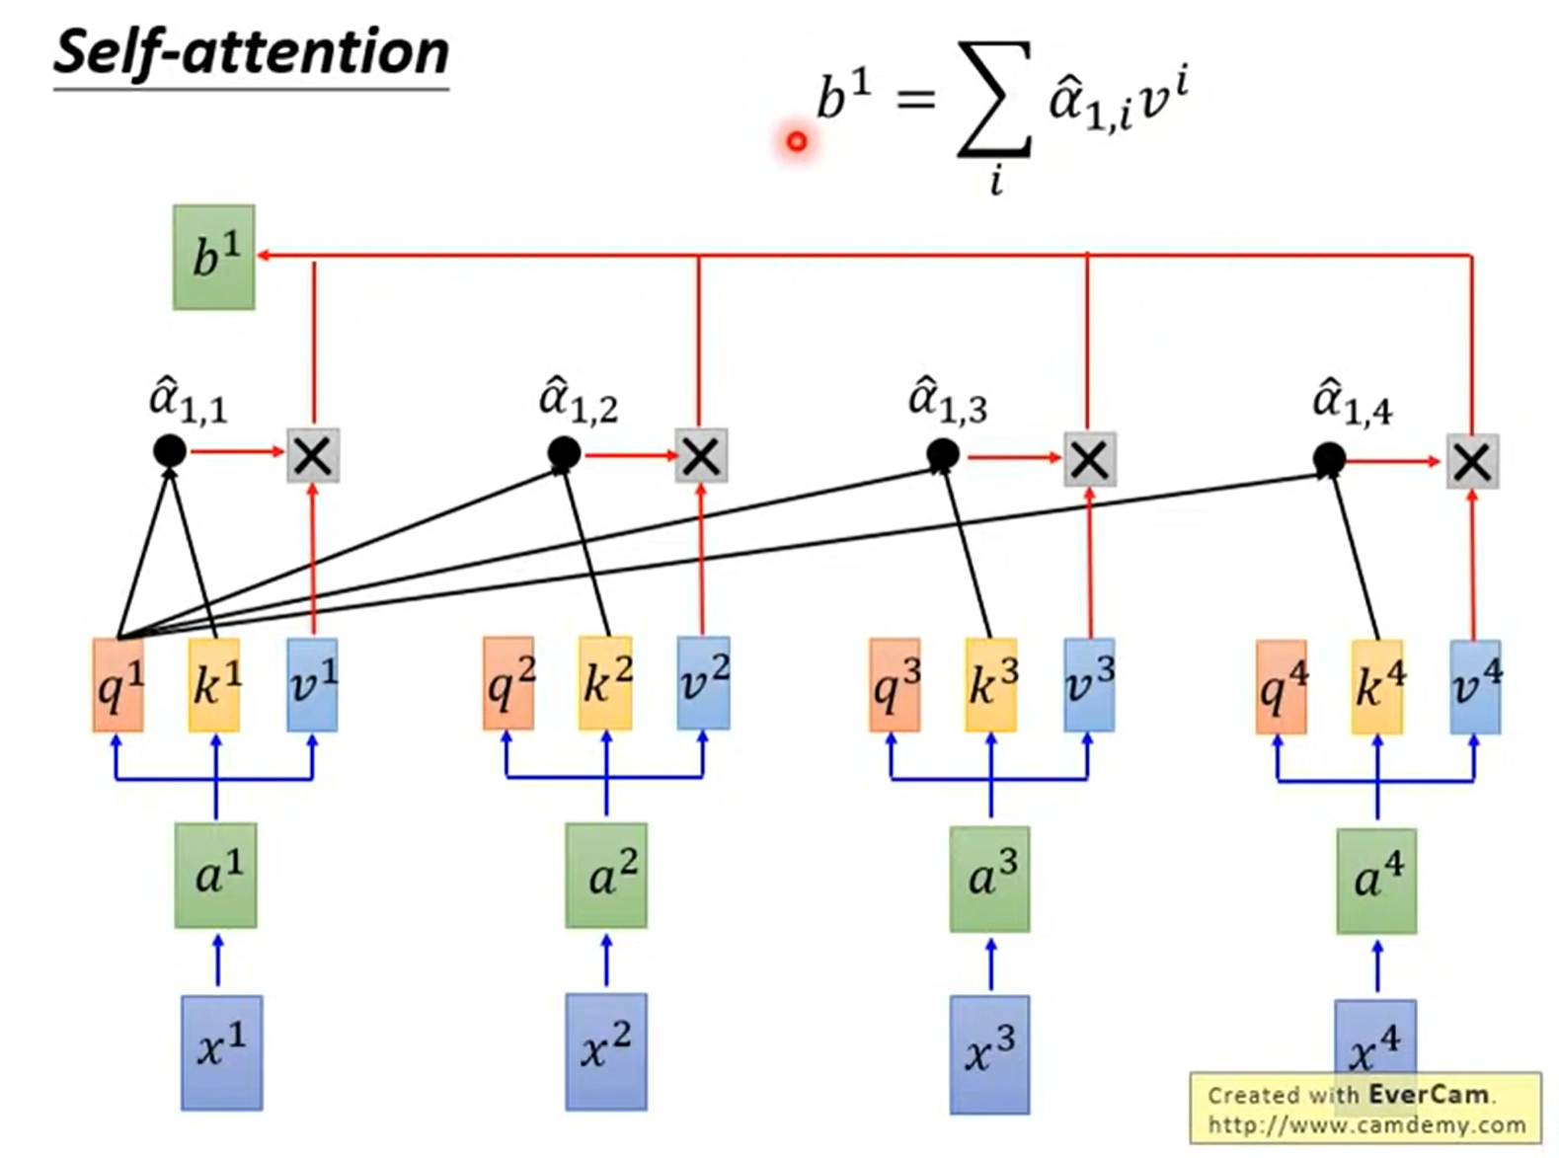
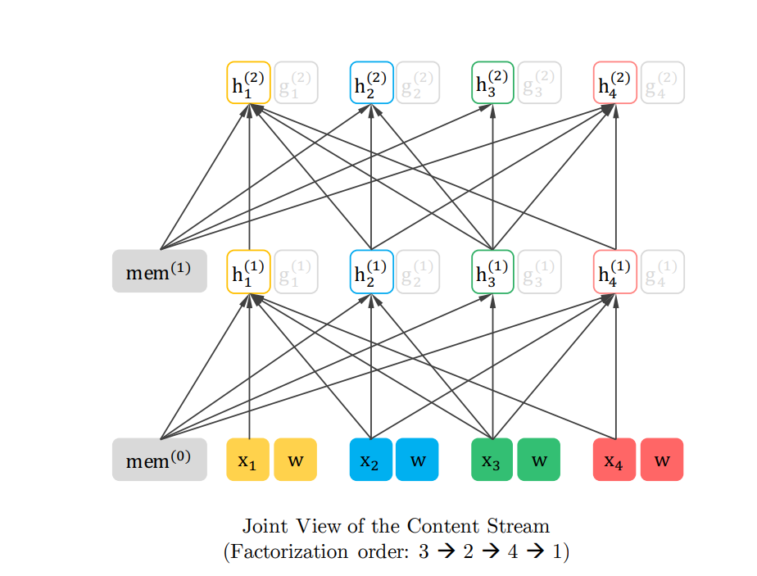
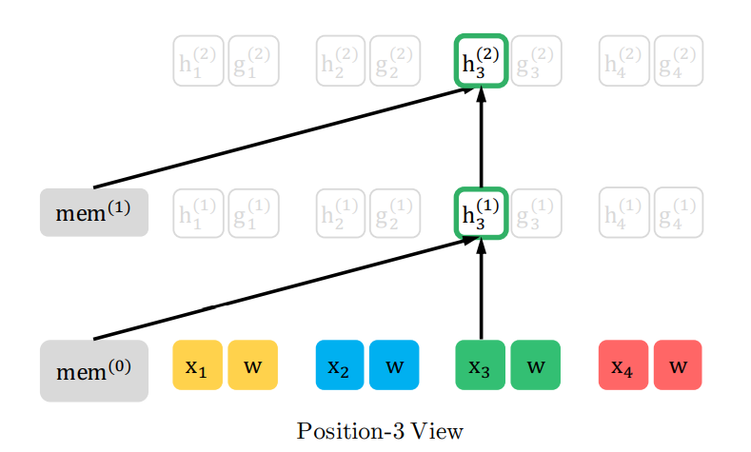
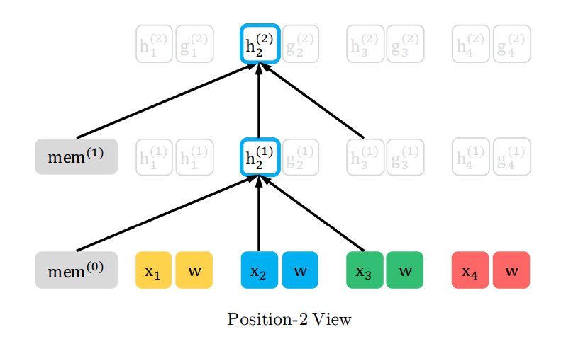
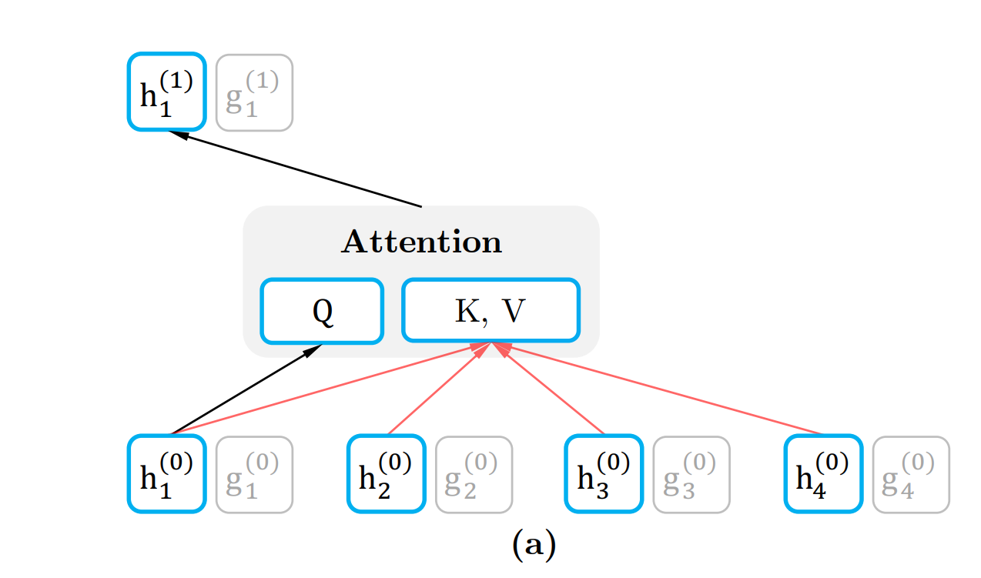
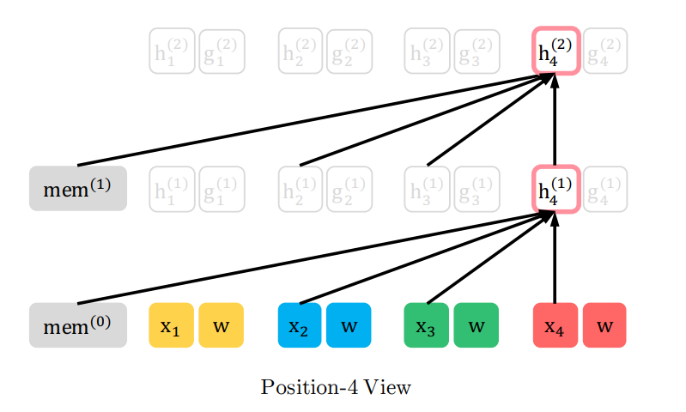
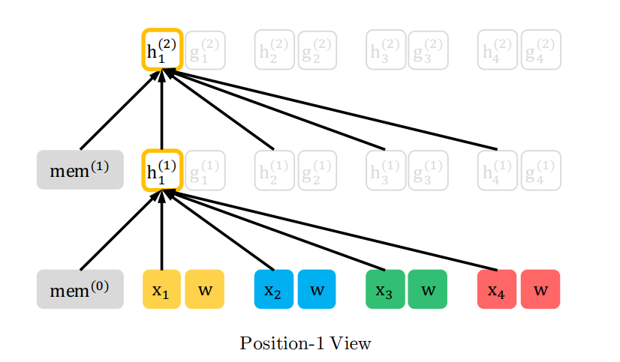
3.4 Implement of PLM
Figure by Hung-yi Lee

Slide 22
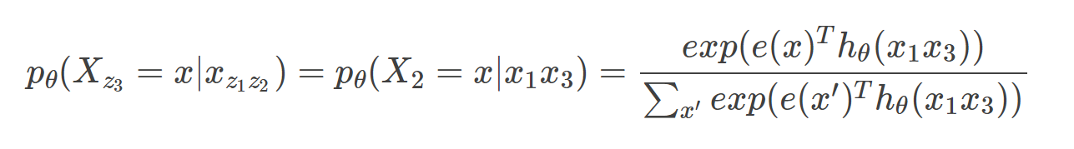
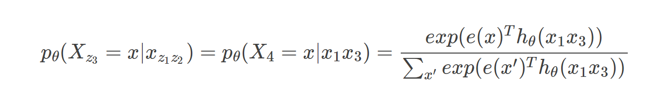
3.5 Problem for simple attention layer
Consider z=[1 3 2 4], z_3 = 2
For example, “I love Hong Kong”.
In this distribution fuction,
p(X_2 = “Kong”|”I”,”Hong”)=
p(X_4 = “Kong”|”I”,”Hong”).
Apparently, “I Hong Kong” will make sence and its appearance likelihood is higher than “I Kong Hong”.
This distribution function is not will defined and is lack of word position’s information.
Consider z’=[1 3 4 2], z_3 = 4
where gθ(xz<t , zt) denotes a new type of representations which additionally take the target position
zt as input
Notes:
where hθ(xz<t ) denotes the hidden representation of xz<t
produced by the shared Transformer network after proper masking. Now notice that the representation
hθ(xz<t ) does not depend on which position it will predict, i.e., the value of zt. Consequently, the
same distribution is predicted regardless of the target position, which is not able to learn useful
representations (see Appendix A.1 for a concrete example). To avoid this problem, we propose to
re-parameterize the next-token distribution to be target position aware

Slide 23
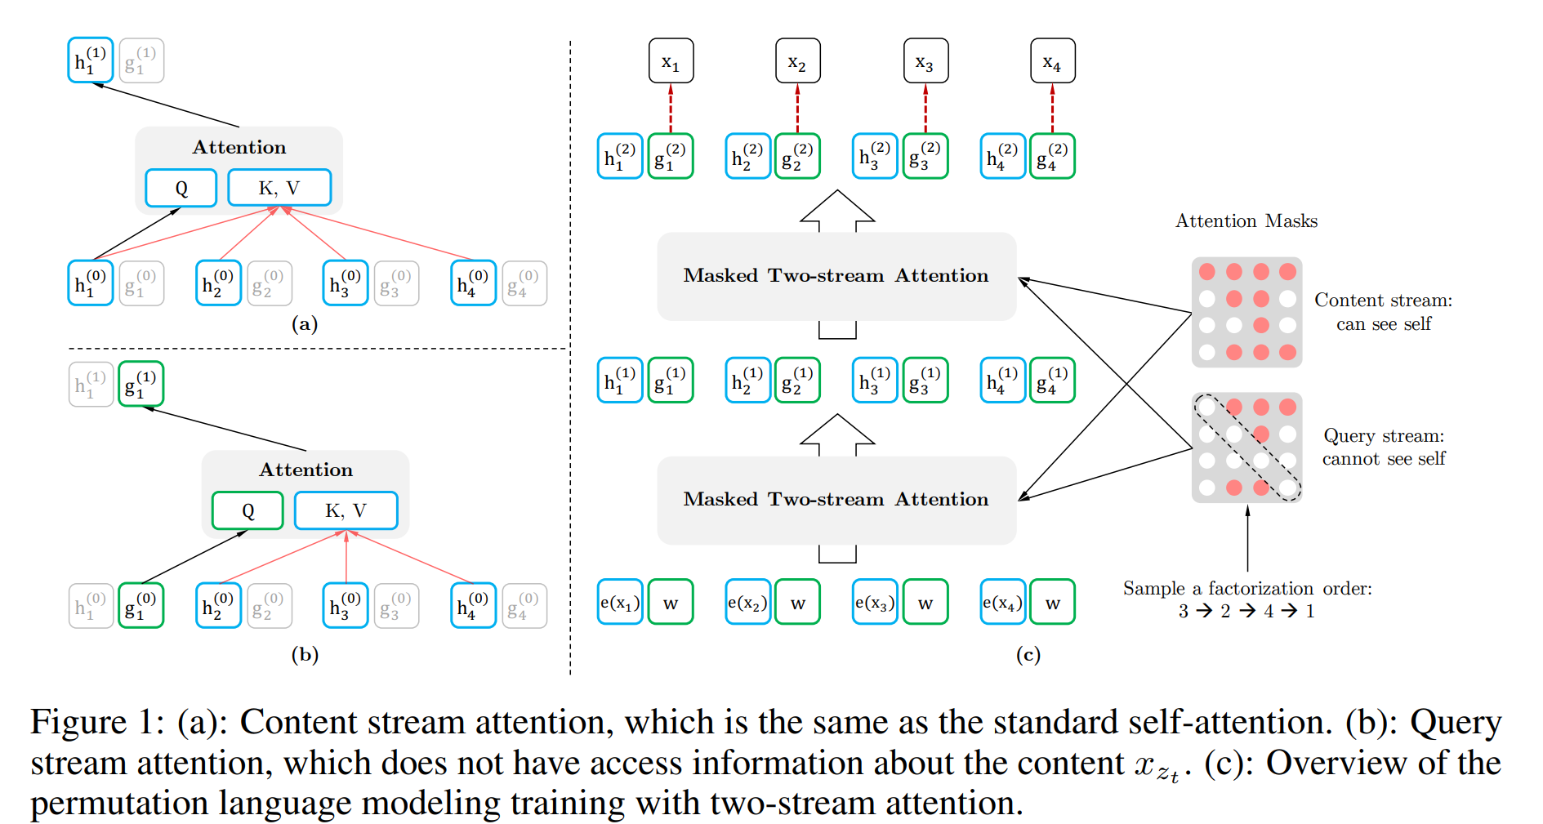
Two-Stream Self-Attention for Target-Aware Representations
• The content representation hθ(xz≤t
), or abbreviated as hzt
, which serves a similar role to the
standard hidden states in Transformer. This representation encodes both the context and xzt
itself.
• The query representation gθ(xz<t , zt), or abbreviated as gzt
, which only has access to the contextual information xz<t and the position zt, but not the content xzt

Slide 24
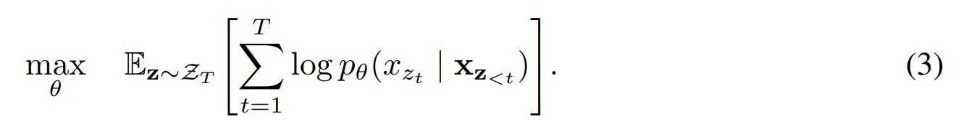
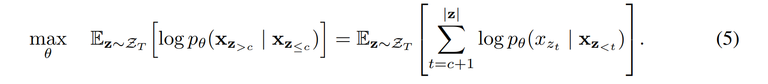
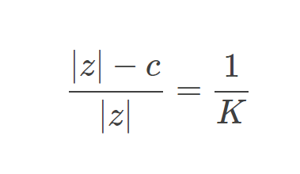
3.6 Partial Prediction
While the permutation language modeling objective (3) has several benefits, it is a much more challenging optimization problem due to the permutation and causes slow convergence in preliminary experiments. To reduce the optimization difficulty, we choose to only predict the last tokens in a factorization order. Formally, we split z into a non-target subsequence z≤c and a target subsequence z>c, where c is the cutting point.
The best K value is between 6 and 7 (better). In fact, if we take the reciprocal of K and convert it to a percentage, we will find that the best ratio is between 14.3% and 16.7%.The percentage of BERT that hides the token as "[MASK]" is 15%

Slide 25
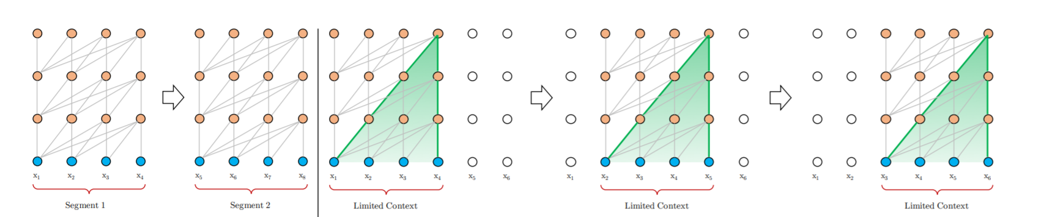
3.7 Transformer-XL
Transformer requires that the input is a fixed-length word sequence.
As a consequence of the fixed context length, the model cannot capture any longer-term dependency beyond the predefined context length. In addition, the fixed-length segments are created by selecting a consecutive chunk of symbols without respecting the sentence or any other semantic boundary. Hence, the model lacks necessary contextual information needed to well predict the first few symbols, leading to inefficient optimization and inferior performance. We refer to this problem as context fragmentation.

Slide 26
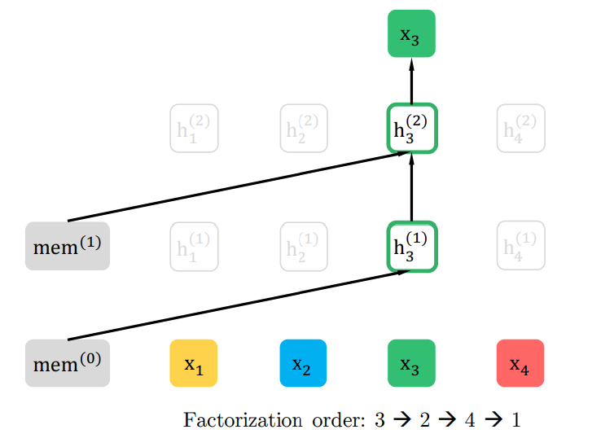
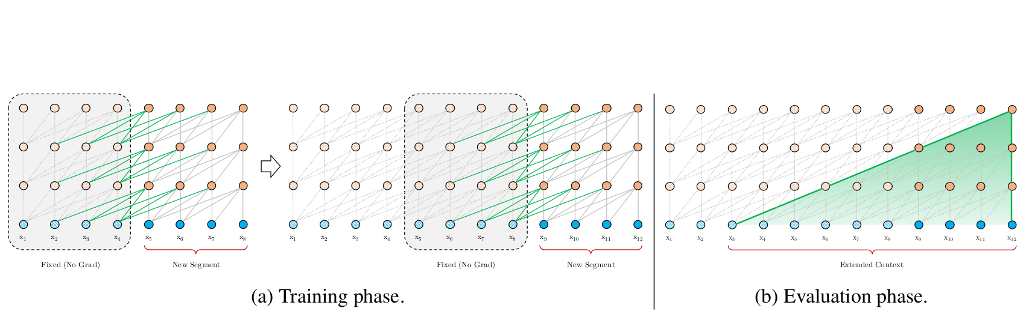
3.7 Segment recurrence mechanism
In fact, the idea is very simple, because generally when training Transformer, the text will be processed into a segment according to a certain length. For example, when BERT is pre-processed, it will first be processed into 512-length samples, even the text before processing may be longer. In this case, there is some longer context information that the model cannot learn
So what Segment Recurrence Mechanism wants to do is. After the previous segment is calculated, all the hidden states (hidden states) calculated by it are saved and put into a Memory, and then in the current segment calculation, the previously saved hidden states and the hidden states of the current segment are saved Put together K and V as the Attention mechanism to obtain longer context information.

Slide 27
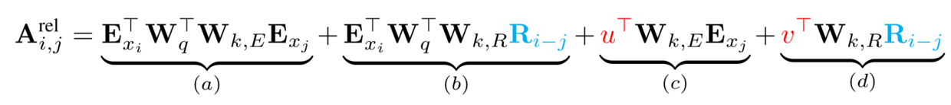
3.7 Relative Positional&Segment Encodings
We store [x1 x2 x3 x4] in memory. However, when we want to use it in next sentence
[x5 x6 x7 x8], the positional enconding in the sentence is changed. We have to use relative positional encoding.
Same method for segments.

Slide 28
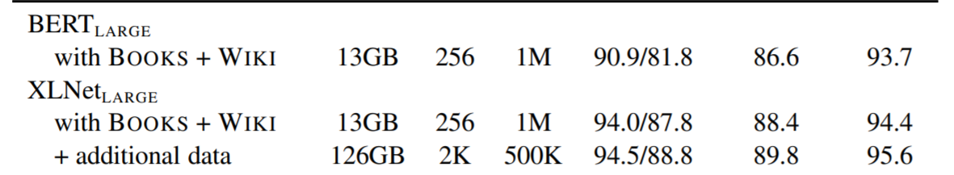
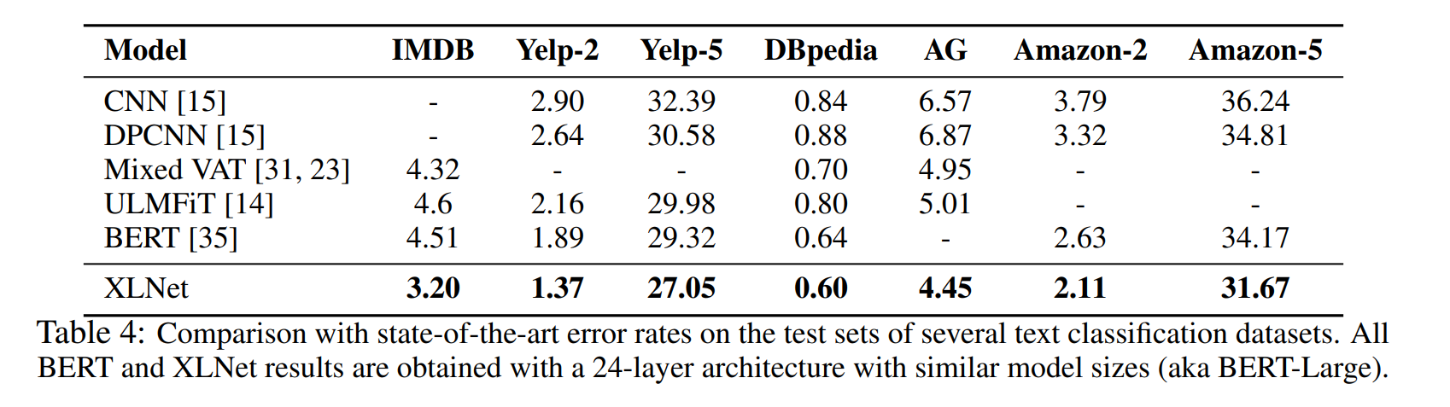
3.8 Pretraining & SOTA in text classification

Slide 29
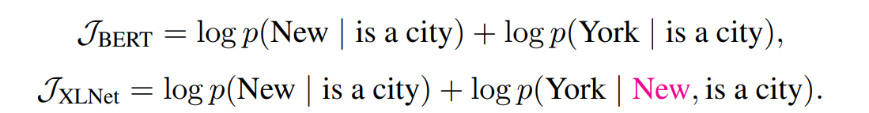
3.9 Comparison with BERT & Own opinions
Both BERT and XLNet perform partial prediction, i.e., only predicting a subset of tokens in the sequence. This is a necessary choice for BERT because if all tokens are masked, it is impossible to make any meaningful predictions. In addition, for both BERT and XLNet, partial prediction plays a role of reducing optimization difficulty by only predicting tokens with sufficient context. However, the independence assumption discussed in Section 2.1 disables BERT to model dependency between targets.
In my perspective, in essene, these two process are equivalent.
Increase the data size used in the pre-training step and utilize transform-XL.
Memory assumption is high. we used Tesla P100 16G and it only supported XLNet-Base.
New idea but the model is complicated

